Slide 1
Integrated Evaluation of Power Sector Decarbonization
Capacity Expansion + Dispatch Analysis for SERC
Smriti Sharma
NETL support contractor
November 4, 2024

Slide 2
Disclaimer
This project was funded by the United States Department of Energy, National Energy Technology Laboratory, in part, through a site support contract. Neither the United States Government nor any agency thereof, nor any of their employees, nor the support contractor, nor any of their employees, makes any warranty, express or implied, or assumes any legal liability or
responsibility for the accuracy, completeness, or usefulness of any information, apparatus, product, or process disclosed, or represents that its use would not infringe privately owned rights. Reference herein to any specific commercial product, process, or service by trade name,
trademark, manufacturer, or otherwise does not necessarily constitute or imply its endorsement, recommendation, or favoring by the United States Government or any agency thereof. The views and opinions of authors expressed herein do not necessarily state or reflect those of the United
States Government or any agency thereof.

Slide 3
Project Team
Smriti Sharma – National Energy Technology Laboratory (NETL) support contractor
Boris Datsov – NETL support contractor
Nadejda Victor – NETL support contractor
Kirk LaBarbara –NETL
Arun K. S. Iyengar – NETL support contractor
John Brewer – NETL
Chris Nichols – NETL

Slide 4
Agenda
Analysis Design
Analysis Approach
MARKAL Data Overview
Translator 1 Data Overview
PROMOD Results Overview
Results Comparison
Conclusion, Value-Add, and Next Steps
Appendix

Slide 5
Analysis Design
Research question: Under an economy-wide Net Zero by 2050 scenario, how do the operational characteristics compare between long-horizon (years-decades) and short-horizon (hours-days) models?
Key elements within the analysis
Element | Handled by | Details | Ensures
Energy Capacity Expansion (long horizon) | MARKAL-ANSWER (MARKAL) | MARKAL provides a least-cost solution to meet the energy demand, subject to constraints of a Net Zero by 2050 scenario | Capacity adequacy
Intermodel Data Translations (interface) | Python translators (crosswalks) under MAGIIC | Bidirectional translated outputs between MARKAL and PROMOD | Resource adequacy
Security-Constrained Economic Dispatch or SCED (short horizon) | Hitachi PROMOD IV® (PROMOD) | PROMOD performs security-constrained economic dispatch analysis for a Net Zero technology mix (focus on SERC) | Energy adequacy
MAGIIC = Markets Analysis and Grid Infrastructure Interdependence Collaborative
SERC = Southeastern Electric Reliability Council
Notes:
MARKAL is a nine-region model. Emissions regulations are based on a cap-and-trade scheme nationwide.

Slide 6
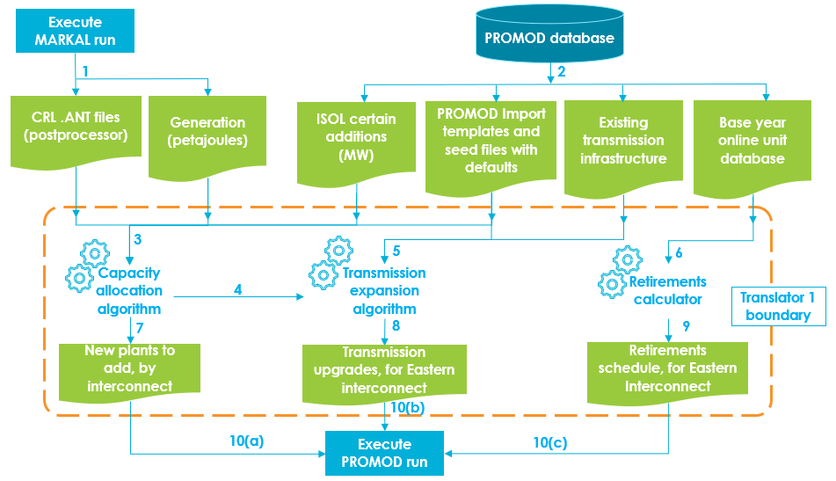
Analysis Approach
Process Flow Diagram for MARKAL-to-PROMOD
Input files are extracted from a MARKAL run and PROMOD baseline database
The two algorithms produce annual capacity expansion data for the period of 2021–2050 with the aim of tracking operational characteristics for the Eastern Interconnect
Today’s focus: SERC
ISOL: independent system operator level
Source: NETL
Notes:
Certain additions (MW) are available from PROMOD.
This capacity is one of the three types: (i) existing but not online yet (January 1, 2022), (ii) under construction, or (iii) planned.
Areas with certain additions of solar will seek new solar first and other offerings from census regions later.
MARKAL generation data change patterns are used to model peak demand on the PROMOD side.

Slide 7
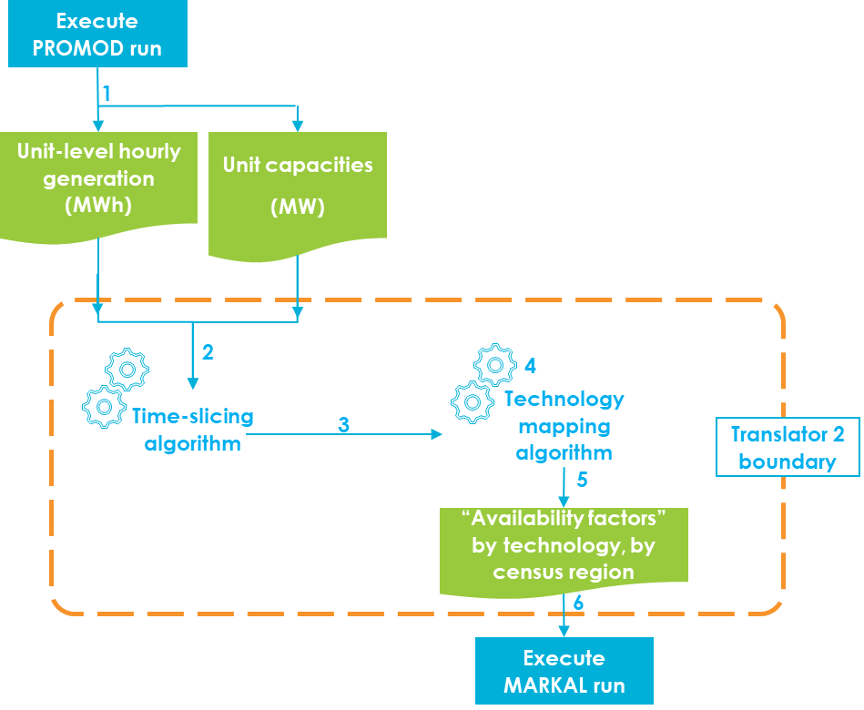
Analysis Approach
Process Flow Diagram for PROMOD-to-MARKAL
Hourly operational characteristics for 32 technology types are extracted from PROMOD for 2050
The hourly data are divided into 12 time slices split by season, day/night, and peak/non-peak
The two algorithms produce annual capacity factor (CF) data at the MARKAL-identified technology level for census regions overlapping with the Eastern Interconnect
Results will focus on SERC only
Source: NETL
Notes:
The twelve time slices are – Summer {AM, PM, Night, Peak}; Winter {AM, PM, Night, Peak}; Intermediate {AM, PM, Night, Peak}

Slide 8
MARKAL Data Overview
Generation Capacity (census regions overlapping with SERC)
Solar PV
Wind
CT = combustion turbine
ST = steam turbine
IC = internal combustion
CCS = carbon capture and storage
PV = photovoltaic
Source: NETL
MARKAL exports existing and new capacity additions required to meet energy demands under Net Zero by 2050 scenario constraints
In addition to solar PV and wind, nuclear and gas turbine new capacity additions are seen in these regions; some retrofits are also introduced in 2030
Notes:
Note: combined heat and power, and residential and commercial solar technologies are excluded from this analysis.

Slide 9
MARKAL Data Overview
A Look at Capacity Factors for the Intermediate Season (2050)
R5 (South Atlantic) and R6 (East South Central) MARKAL regions roughly overlap with the SERC region and the MARKAL-reported capacity factors in these regions are displayed.
In 2050, no combined cycle technologies are expected to run in the intermediate season.
Similarly, CFs for other technologies, including nuclear, solar PV, wind, conventional hydroelectric, gas and steam turbines, and biomass + CCS technologies, are available from MARKAL results

Slide 10
Translator 1 Data Overview
Demand Modeling
MARKAL generation (petajoules, five-year level) is interpolated and used as a proxy for demand
Generation trends are then used to model peak demand at the ISO level in PROMOD
Eastern Interconnect’s peak demand trends between 572 GW and 755 GW between 2021 and 2050; Southeast makes up about 23% of Eastern Interconnect's modeled demand each year
Source: NETL

Slide 11
Translator 1 Data Overview
Annual New Capacity Demand, Supply, and Retirements
The annual new capacity requirement at the ISO level was determined using ISO-level peak demand and retirements
Shortfalls occur in the New England ISO in 2043–2045 and 2048–2050; in all other years, there is sufficient new capacity available from MARKAL to meet the PROMOD requirements
The SERC requirement for new capacities is met in all years
Source: NETL

Slide 12
Translator 1 Data Exploratory Analysis
Transmission Expansion
130 unique transmission links are upgraded to account for the generation capacity increase during the study period
The biggest single upgrade happens in 2043 when links connected to the MISO – Gulf region are increased by about 14.5 GW each
Driven by a big capacity increase in the 2040-2045 period.
Number of upgrades between 2021 and 2050 | 922
Number of unique transmission links upgraded | 130
Biggest single-year upgrade | 14.5 GW
TVA = Tennessee Valley Authority; MISO = Midcontinent Independent System Operator
Notes:
Purpose: all resources are dispatchable. We stopped at energy.

Slide 13
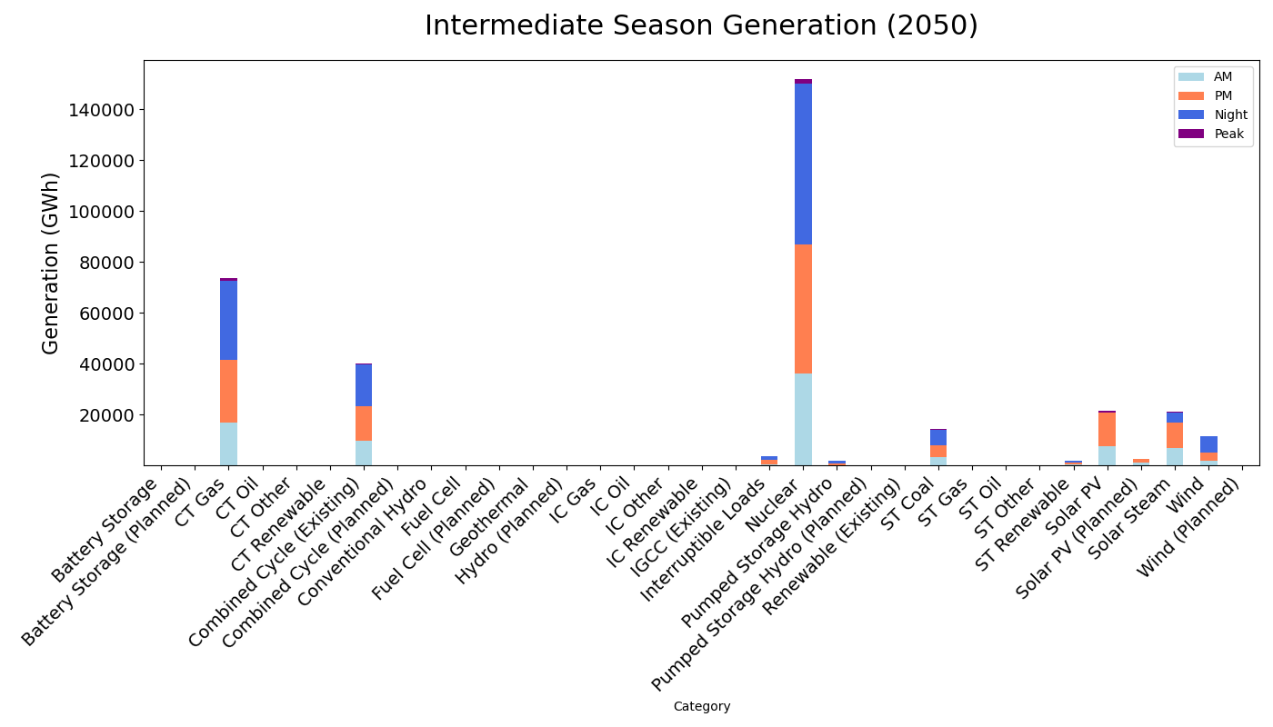
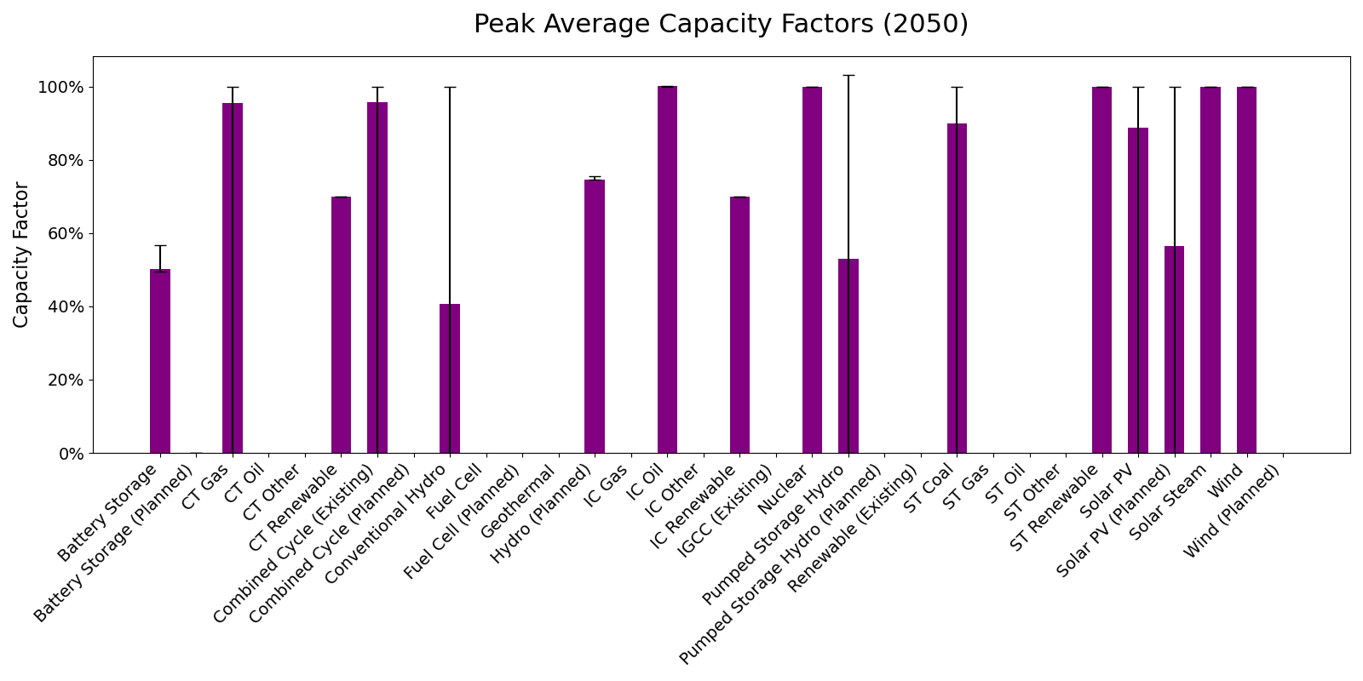
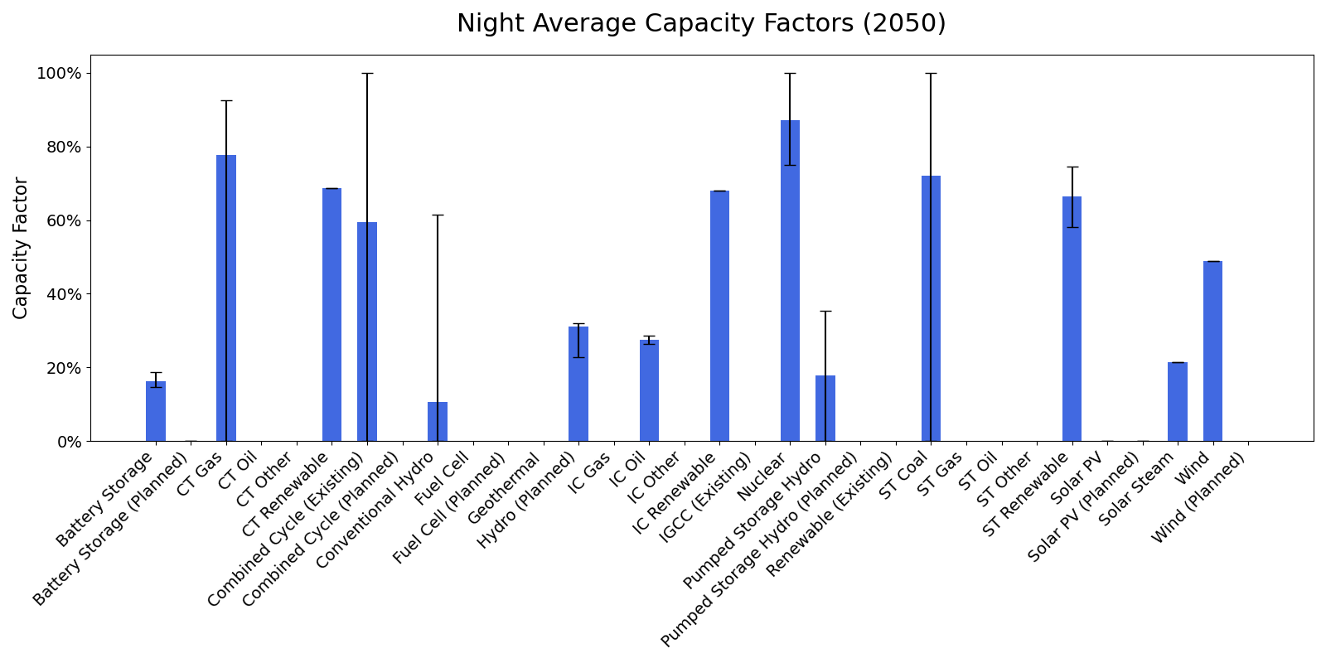
PROMOD Results Overview
Capacity Factors for Intermediate Season (2050) – Peak and Night only
Nuclear, CT gas, and ST coal show greater than 60% CFs throughout the season
Some PROMOD assumptions that might lead to these results
Operational costs for new plants based on existing plants
The same generation “profile” applied to all wind-powered units in SERC
Differences in unit definitions between MARKAL and PROMOD
Nuclear is the highest-generating technology in the intermediate season of 2050, followed by CT gas and combined-cycle plants
Notes:
Column height indicates the average capacity factors across SERC units for a given time of day in the year 2050.
Error bars indicate the maximum and minimum capacity factors observed by a single unit.
A peak time slice consists of 28 hours of the highest overall generation in the intermediate season

Slide 14
Results Comparison
Between MARKAL and PROMOD outputs
There are differences in CFs of several technologies, and in many time slices, between MARKAL and PROMOD. For example,
MARKAL does not expect combined cycle technologies to operate at all, but PROMOD dispatch suggests 60% or higher CFs.
There are stark differences in hydro CF estimation between MARKAL and PROMOD.
MARKAL’s CFs are lesser than PROMOD’s for nuclear, solar, and wind technologies in the peak slice.
CF variance also depends on time-of-day for many technologies on the PROMOD side, not as much on the MARKAL side (hydro, nuclear, natural gas combined cycle).
Notes:
Note: Net Zero by 2050 is enforced at the national level in this exercise; hence, net positive emissions in SERC would be balanced by net negative emissions elsewhere in the United States

Slide 15
Conclusion, Value-Add, and Next Steps
Conclusion:
There are differences in operating characteristics of generation technologies between short-horizon and long-horizon models due to spatial-temporal differences between modeling paradigms
There is a need for iterative convergence of assumptions and results between multi-horizon models to conduct a robust deep decarbonization analysis
Value add:
This approach enables a joint expansion–dispatch analysis with a focus on mitigating discrepancies
This analysis captures inter-region transmission upgrades instead of using a copperplate grid; it also uses baseline operating fleet data for the U.S. Eastern Interconnect through Hitachi PROMOD IV®*
Forthcoming NERC standards will require such analysis capability
Next steps:
Bridge the gap (convergence) by conducting iterative data exchanges between PROMOD and MARKAL
Take a closer look at fuel costs and heat rate assumptions for specific technologies
* PROMOD model data can only be shared with active PROMOD license holders

Slide 16
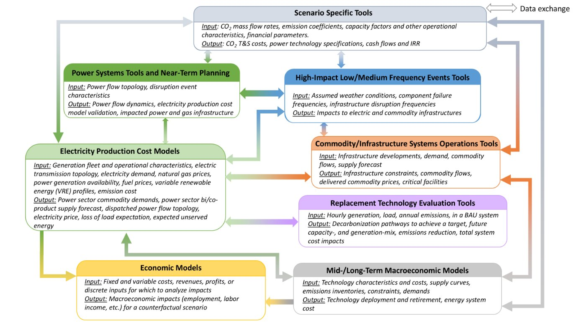
What Does MAGIIC Do?
Existing interlinkages
The Market Analysis and Grid Infrastructure Interdependence Collaborative (MAGIIC) is a Python framework that enables standardization of data-transfers between commercially and industrially well-known models that are inherently different from each other at the geographic, timescale, and technology levels
T&S = transport and storage; IRR = internal rate of return; BAU = business as usual
Source: NETL
Notes:
In the current analysis, an integrated evaluation for SERC is performed; it combines and compares results between long-term macroeconomic (capacity expansion) models and electricity production cost models (hourly dispatch)

Slide 17
Questions/ Comments
John Brewer, Kirk LaBarbara
John.brewer@netl.doe.gov,
Kirk.labarbara@netl.doe.gov

Slide 18
Appendix

Slide 19
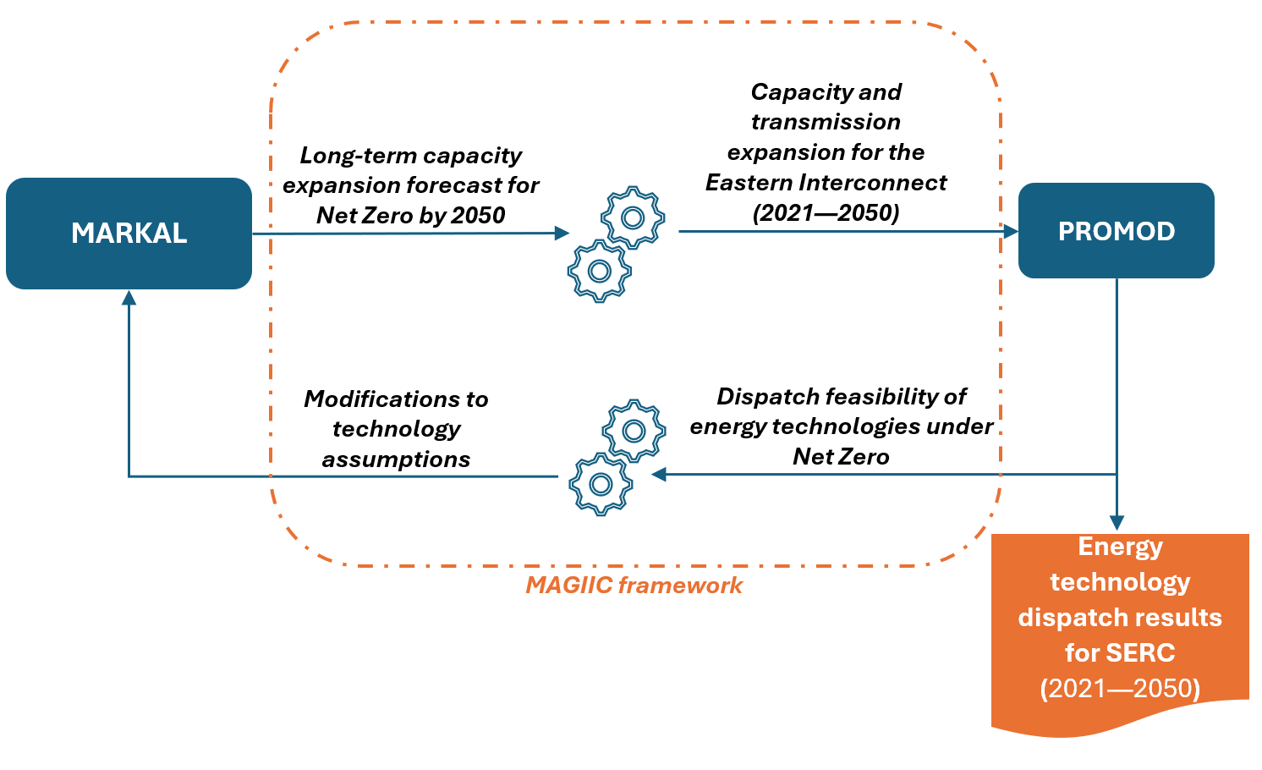
Analysis Schematic
Integrated MARKAL-PROMOD Analysis
Source: NETL

Slide 20
Time Slices in MARKAL–TIMES
Season | Months | Days Annually | Hours Annually | Peak | Night | Day-AM | Day-PM
Intermediate | April, May, October, November | 122 | 2928 | 0.96% of 2928 | 20:00–06:00 | 06:00–12:00 | 12:00–20:00
 |  |  |  | (28 hours) | 10 hours | 6 hours | 8 hours
Summer | June, July, August, September | 122 | 2928 | 0.80% of 2928 | 21:00–05:00 | 05:00–12:00 | 12:00–21:00
 |  |  |  | (24 hours) | 8 hours | 7 hours | 9 hours
Winter | December, January, February, March | 121 | 2904 | 0.97% of 2904 | 21:00–05:00 | 05:00–12:00 | 12:00–21:00
 |  |  |  | (28 hours) | 8 hours | 7 hours | 9 hours
MARKAL–ANSWER assumes peaks to occur only during Day-AM
Peak generation hours are calculated individually for each year and subtracted from Day-AM

Slide 21
Biggest transmission upgrade (2043)
Name | StartDate | ShortName | FwdEnergyLimit (MW) | BackEnergyLimit (MW) | FwdEnergyLimitPrevIter (MW) | BckEnergyLimitPrevIter (MW)
TVA to MISO – Gulf | 2043-01-01 | TVAGulf | 1442 | 35388 | 1442 | 20893
MISO – Arkansas to MISO – Gulf | 2043-01-01 | ArkGulf | 1732 | 36135 | 1732 | 21640
MISO – Gulf to Southeastern | 2043-01-01 | GulfSE | 36135 | 1732 | 21640 | 1732
MISO – Gulf to MISO – Mississippi | 2043-01-01 | MIGLMIMS | 36473 | 2070 | 21978 | 2070

Slide 22
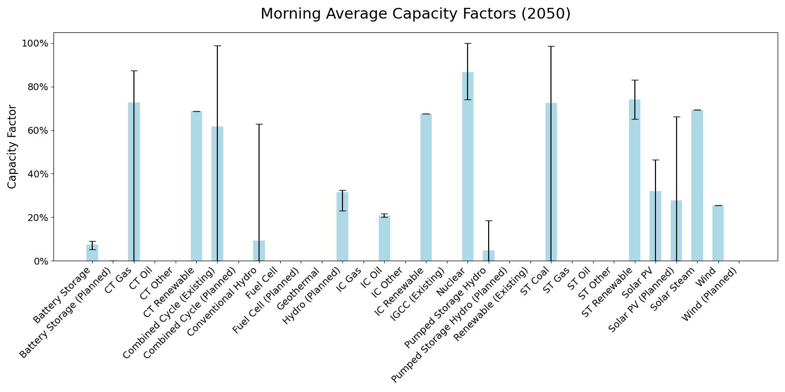
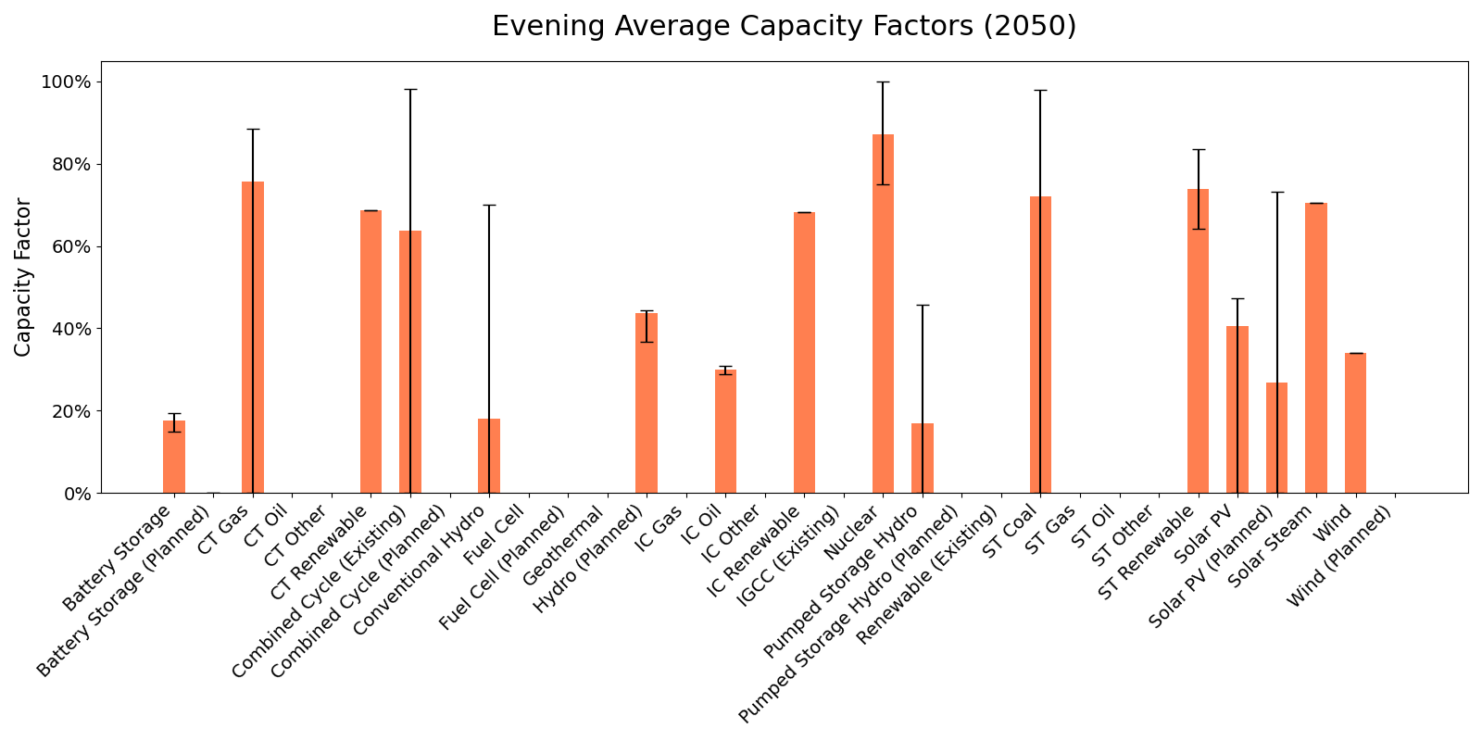
PROMOD output for other intermediate time-slices

Slide 23
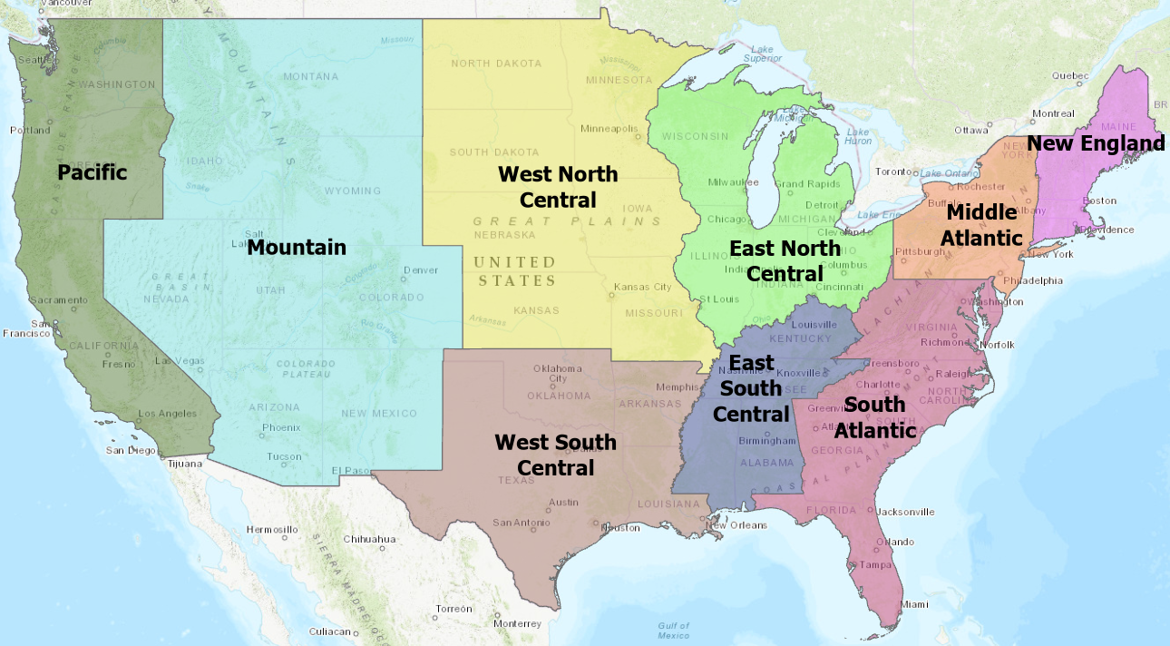
MARKAL Data Setup
New capacity to be added (GW), resulting from least-cost optimization, is extracted from MARKAL
At the census-region level (nine census regions make up the entire United States)
On a five-year basis (2005–2075)
By technology type (200+ raw technology types)
Existing technology (GW) is also available
Source: NETL
Census region-level regional representation used in MARKAL following state lines

Slide 24
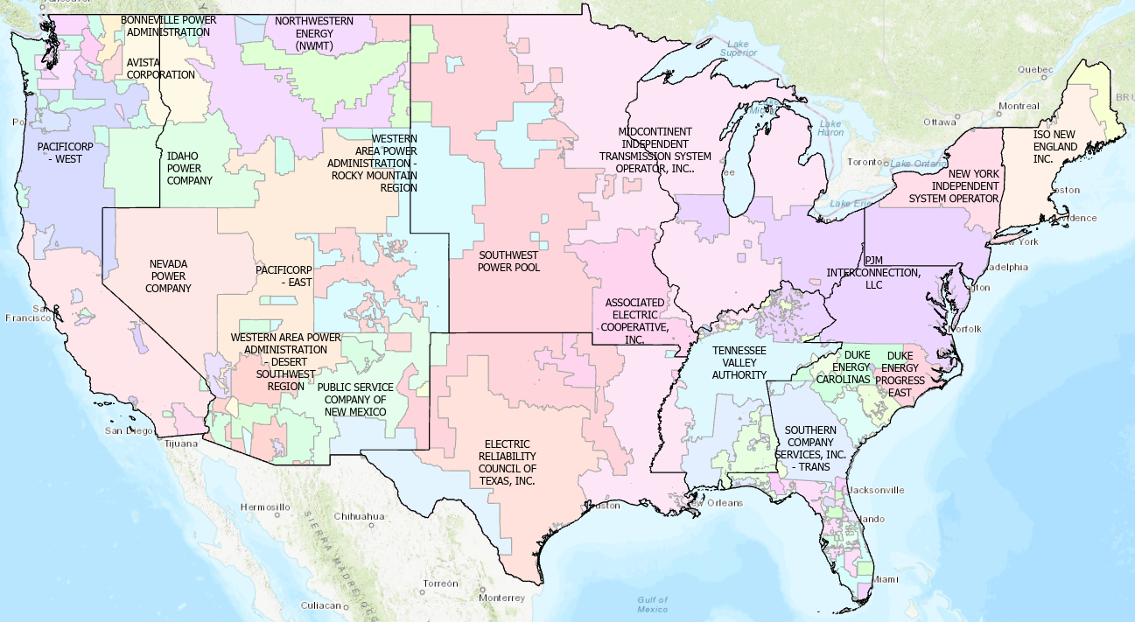
Geographical Dissimilarities between MARKAL and PROMOD
Census Region | Census Region Code (MARKAL)
New England | R1
Middle Atlantic | R2
East North Central | R3
West North Central | R4
South Atlantic | R5
East South Central | R6
West South Central | R7
Mountain | R8
Pacific | R9
ISO Name | Roughly Overlapping Census Region(s)
New England | R1
PJM | R2, R3, R5, R6
New York | R2
Southeast | R5, R6
Southwest Power Pool | R4, R7
Midcontinent ISO | R3, R4, R7
Florida | R5
Source: NETL
An overlay of census regions on control areas. PROMOD expects inputs at the transmission-area level, which largely follow control area lines in this map. Each area is a part of one of Eastern Interconnect, Western Interconnect, or ERCOT.

Slide 25
MARKAL Data Exploratory Analysis
Carbon Dioxide (CO₂) Emissions (All Sectors)
The electricity sector is designed in MARKAL to become net negative by 2035 (bio-energy with carbon capture and storage deployment)
2050 onwards, land use and a net-negative electricity sector together balance the system to net zero economy-wide
Decarbonization is also seen in transportation (out of the scope for this work)
Source: NETL

